Slide 1
JOB MARKET ANALYSIS PROJECT
Project ID :- PTID-CDA-MAY-25-450
📘
Report:
This Job Market Analysis report is designed to provide a comprehensive overview of the current employment landscape, using real-time data visualized through Power BI. The objective is to uncover meaningful insights into the demand for job roles, industry-wise opportunities, salary trends, educational preferences, and regional job distribution.
Your aim of this project is to analyze the job market trends for positionsby analyzing job data which includes 742 rows and 42 features like Jobtitle, Salary Estimate, Job Description, Rating, Company, Location,Company, Headquarters and many more acquired from various sources.Your goal is to identify the most in-demand skills, qualifications, jobresponsibilities and provide insights that can inform job seekers andemployers.

Slide 2
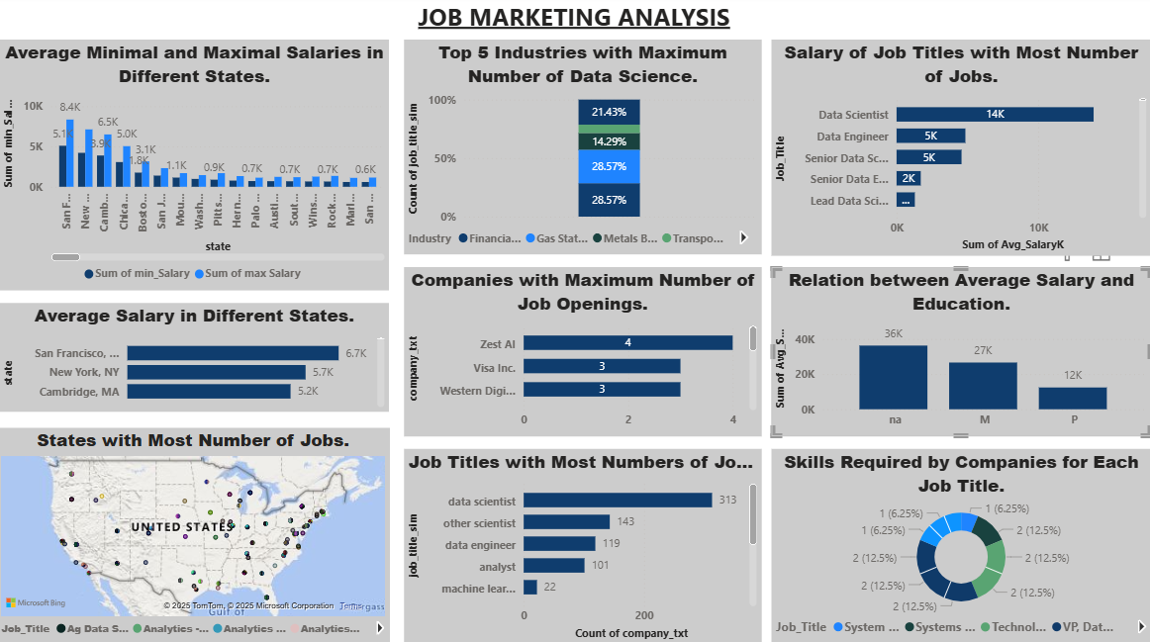
:DashBoard:

Slide 3
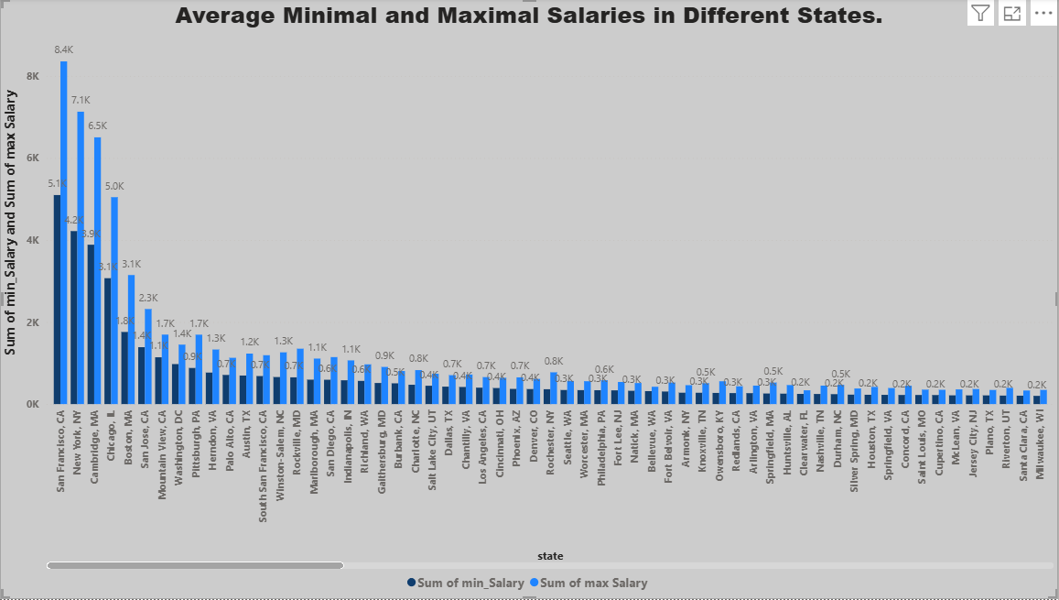
Average Minimal and Maximal Salaries in Different States.
Description:
A bar chart comparing lower and upper salary ranges for jobs across various states.
Example Data:
San Francisco, CA: High upper and lower salary values
New York, NY: Slightly lower than SF
San Jose, CA, Boston, MA: Close third and fourth
Insight:
California cities offer the highest salary ranges, making them attractive for
high-skilled professionals.

Slide 4
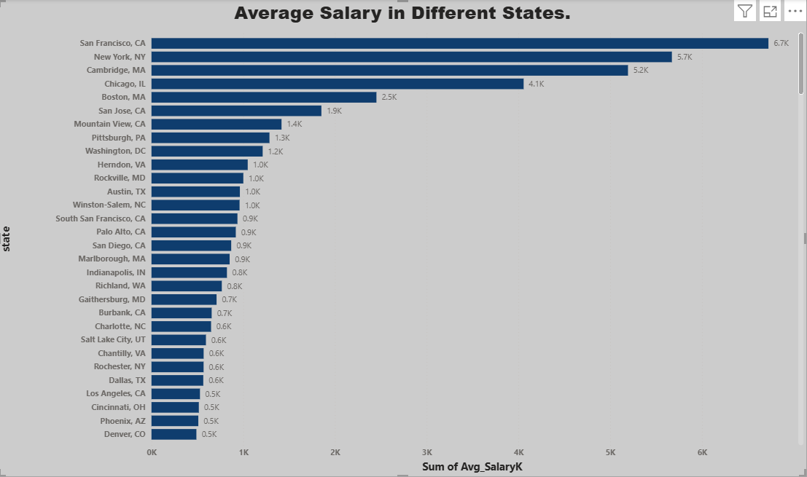
Average Salary in Different States
Description:
visualization showing salary averages across states.
Insight:
Western and Northeastern U.S. states show higher average salaries, while interior and southern regions show relatively moderate pay.

Slide 5
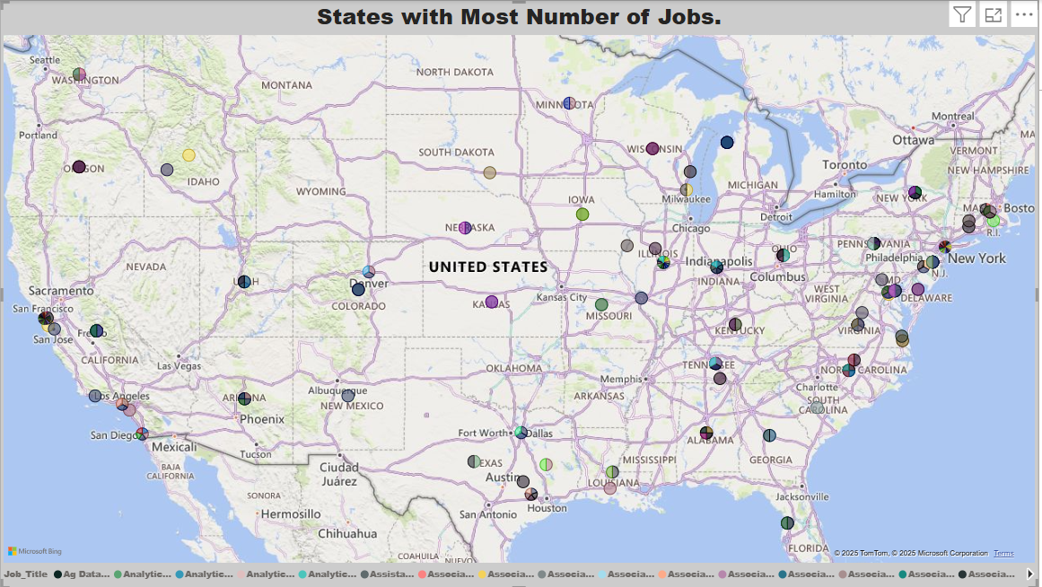
States with Most Number of Jobs
Description:
A bar chart showing the number of job openings in different states or cities in the U.S.
Top Locations:
San Francisco, CA – 8.4K jobs
New York, NY – 7.1K jobs
Cambridge, MA – 6.5K jobs
Chicago, IL – 5.0K jobs
Boston, MA – 3.1K jobs
Insight: California, especially San
Francisco, is the top location for
data-related jobs, followed by
NewYork and Massachusetts

Slide 6
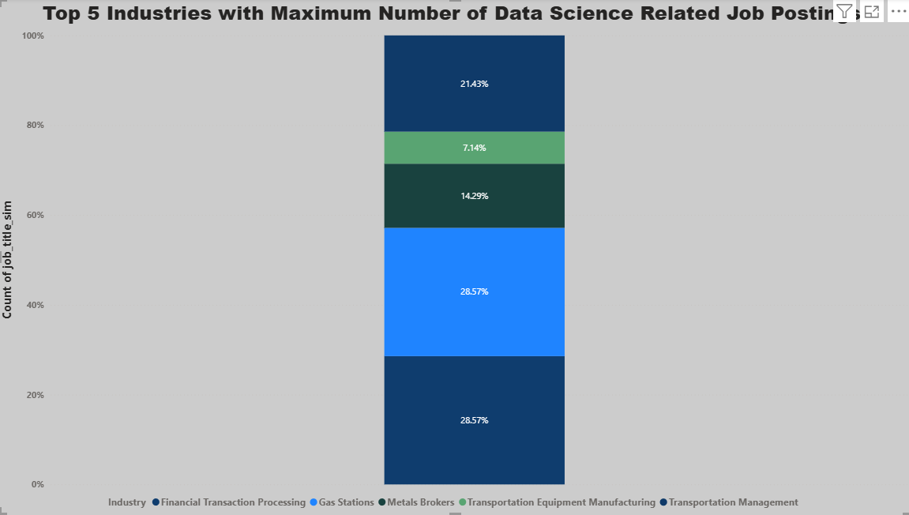
Top 5 Industries with Maximum Number of Data Science Related Job Posting.
Description:
Horizontal bar chart showing industry-wise job count.
Top 5 Industries:
Financial Transaction Processing
Gas Stations
Metals Brokers
4. Transportation Equipment Manufacturing
Transportation Management
Insight:
There’s a surprising presence of data jobs even in non-traditional tech sectors like gas stations and metal brokerage.

Slide 7
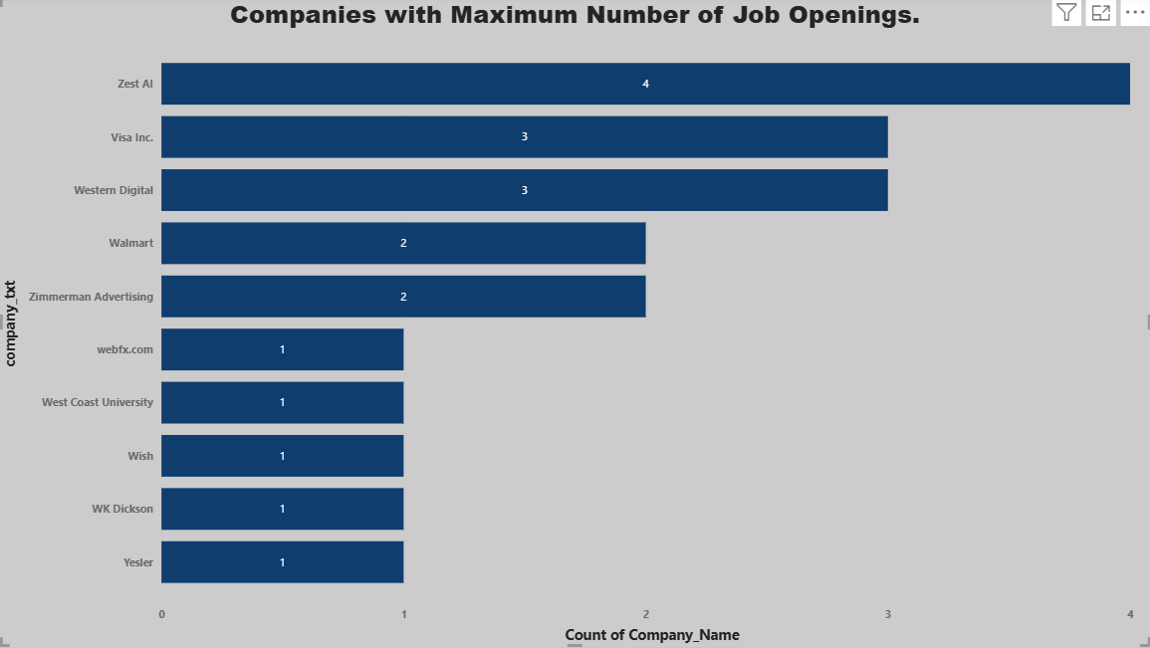
Companies with Maximum Number of Job Openings.
Description:
Bar chart listing top companies hiring.
Top Companies:
Zest AI- Visa Inc
Western Digital
Walmart
Zimmerman Advertising
Insight:
Tech and financial companies dominate hiring, but there are also opportunities in retail and media.

Slide 8
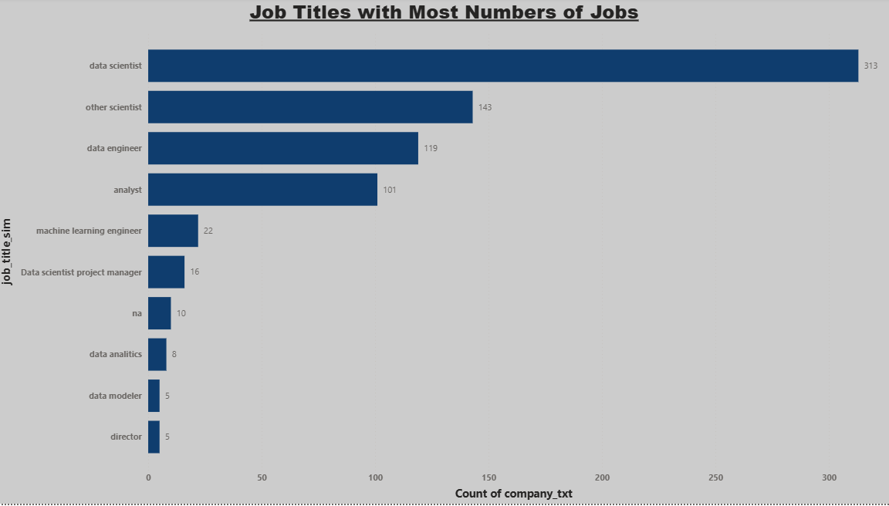
Job Titles with Most Numbers of Jobs
Description:
Bar chart showing the most common job titles in the data field.
Top Roles:
Data Scientist
Data Engineer
Senior Data Scientist
Senioread Data Scientist
Data Engineer
Insight:
Data Scientist and related roles are in high demand across different experience levels.

Slide 9
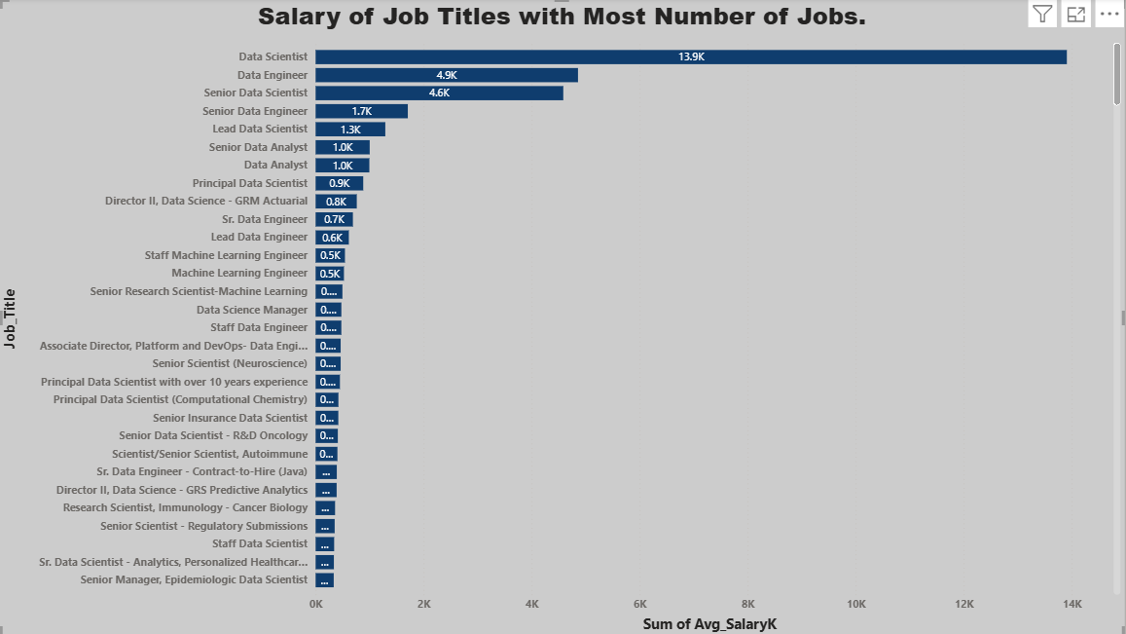
Salary of Job Titles with Most Number of Jobs
Description:
Bar chart showing salary averages for various job titles.
Top-Paying Roles:
Lead Data Scientist
Principal Data Scientist
Director
level roles
Staff Machine Learning Engineer
Insight:
Leadership and specialized roles like Machine Learning Engineers command the
highest salaries.

Slide 10
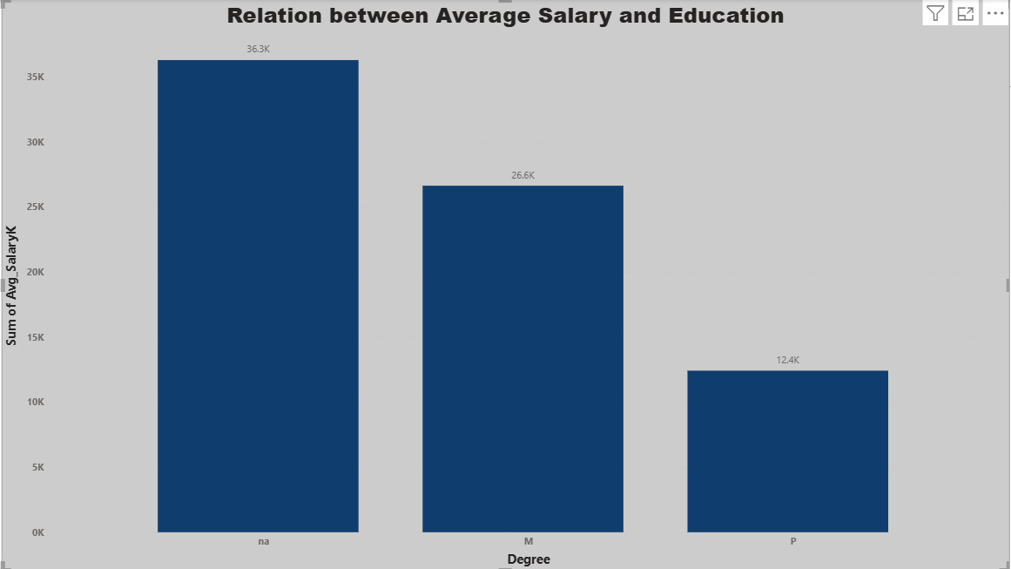
Relation between Average Salary and Education
Description:
Bar chart comparing education level (PhD, Master's, etc.) with average
salary.Insight:
PhDs earn the highest average salaries.
Master’s degree holders also earn well.
There’s a clear salary progression with higher education.

Slide 11
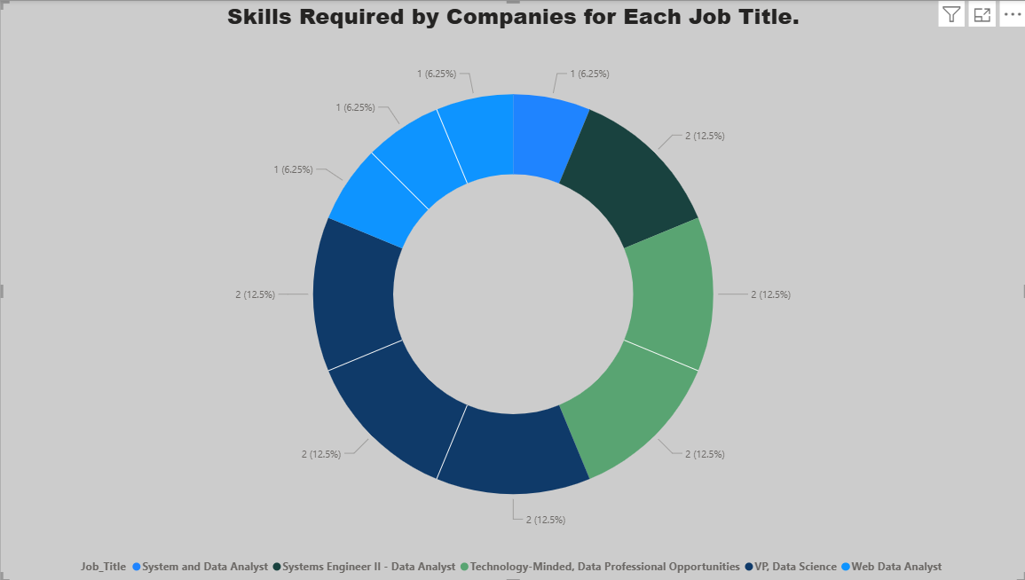
Skills Required by Companies for Each Job Title.
Description: Bar chart of job postings vs specific skills.
Top Skills:
1. Python (23.09%)
2. Excel (22.85%)
3. AWS (10.37%)
4. General data tools
Insight:
Python and Excel remain essential. AWS knowledge boosts employability in data roles.

